Slide 1

Creating a Service
DWPA Services and Chatbot

Slide 2
Overview
Create a simple service for the installation of a Microsoft Office product (Excel, Word, PowerPoint or Access)
Service will capture
  User’s name
  Phone number
  Computer Name
  Office product they wish to install
  Whether they have an existing license
  Which department gets the bill if they require a license
  Additional Notes

Slide 3
DWPA
The interface allows for the development and management of enhanced catalog services
  Workflows
  Catalogs
  Banners
  Marketplaces
  Users
  connectors

Slide 4
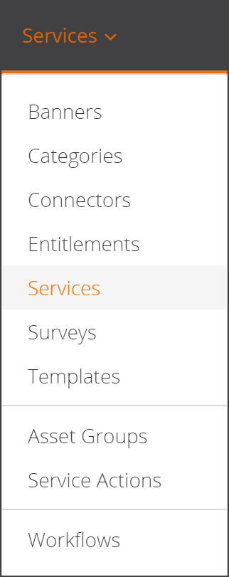
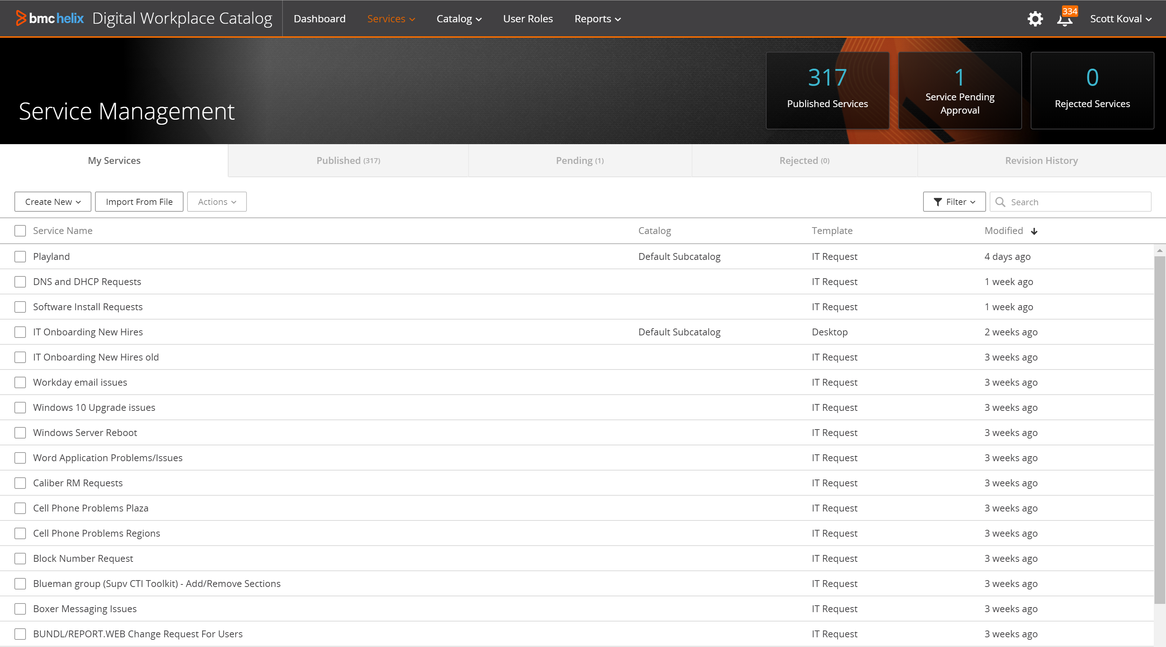
DWPA Service
Services screen lists all services and is the main interaction screen for service creation, publishing end editing

Slide 5
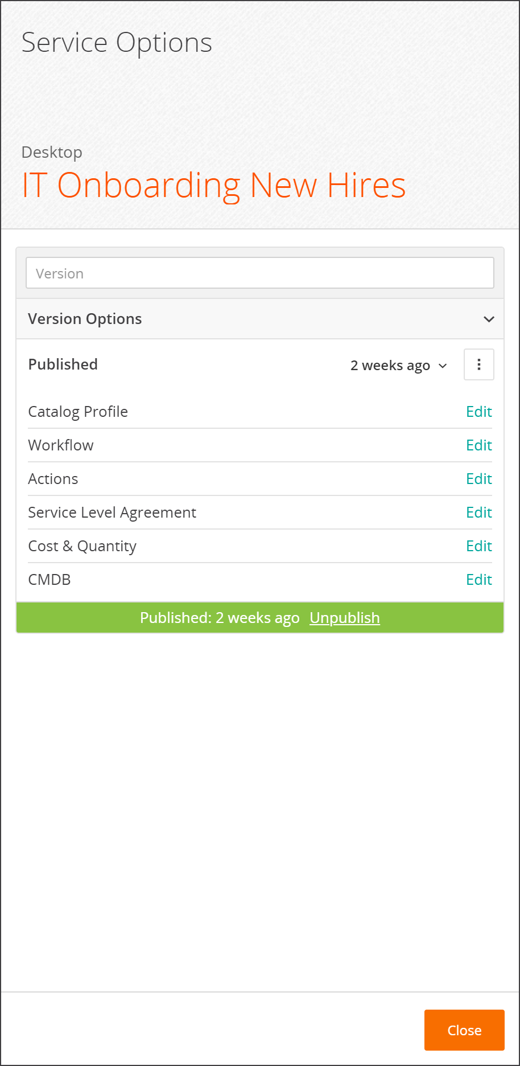
Service Settings

Slide 6
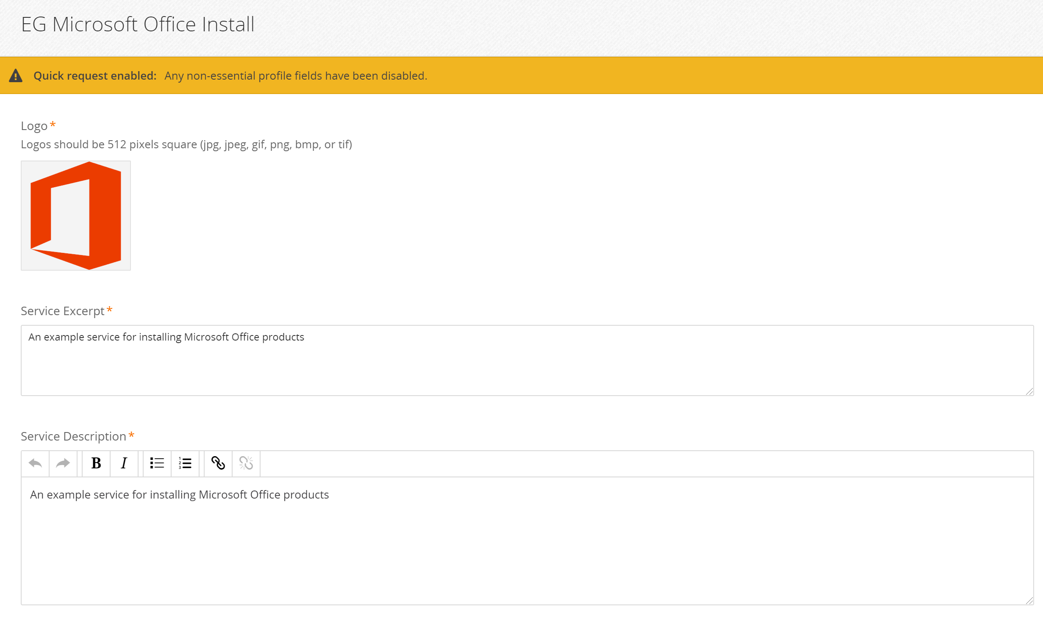
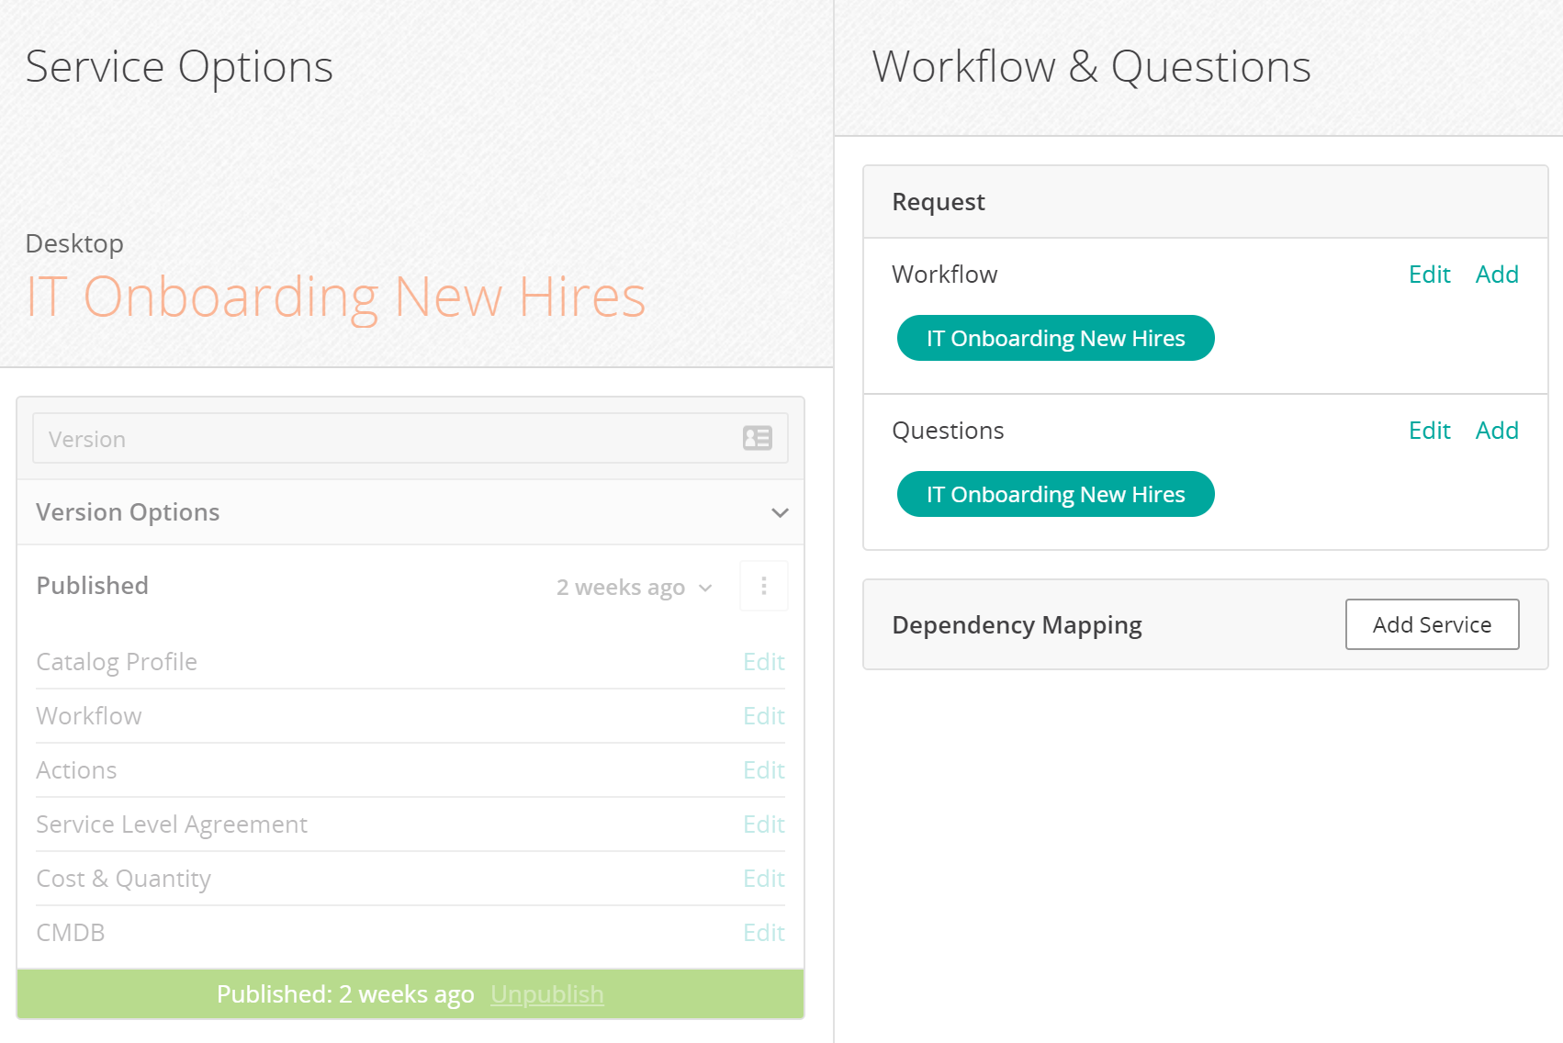
Defining the Service
You set the icon, description and keywords in the Catalog Profile
Defining the variables and questions/answers used in the service are handled in two separate areas: Workflow and Questions
Workflow defines the variables and process workflow of the service
Questions defines the questions and question flow presented to the user. This is also where you can wordsmith your questions, define descriptions, set hidden and required fields and present defaults

Slide 7

Demo: Create the service
On the Services screen, Create New/Service
Name the service (something unique for yourself since we’re all in the same environment)
Attach an icon or use the one here and provide a description

Slide 8
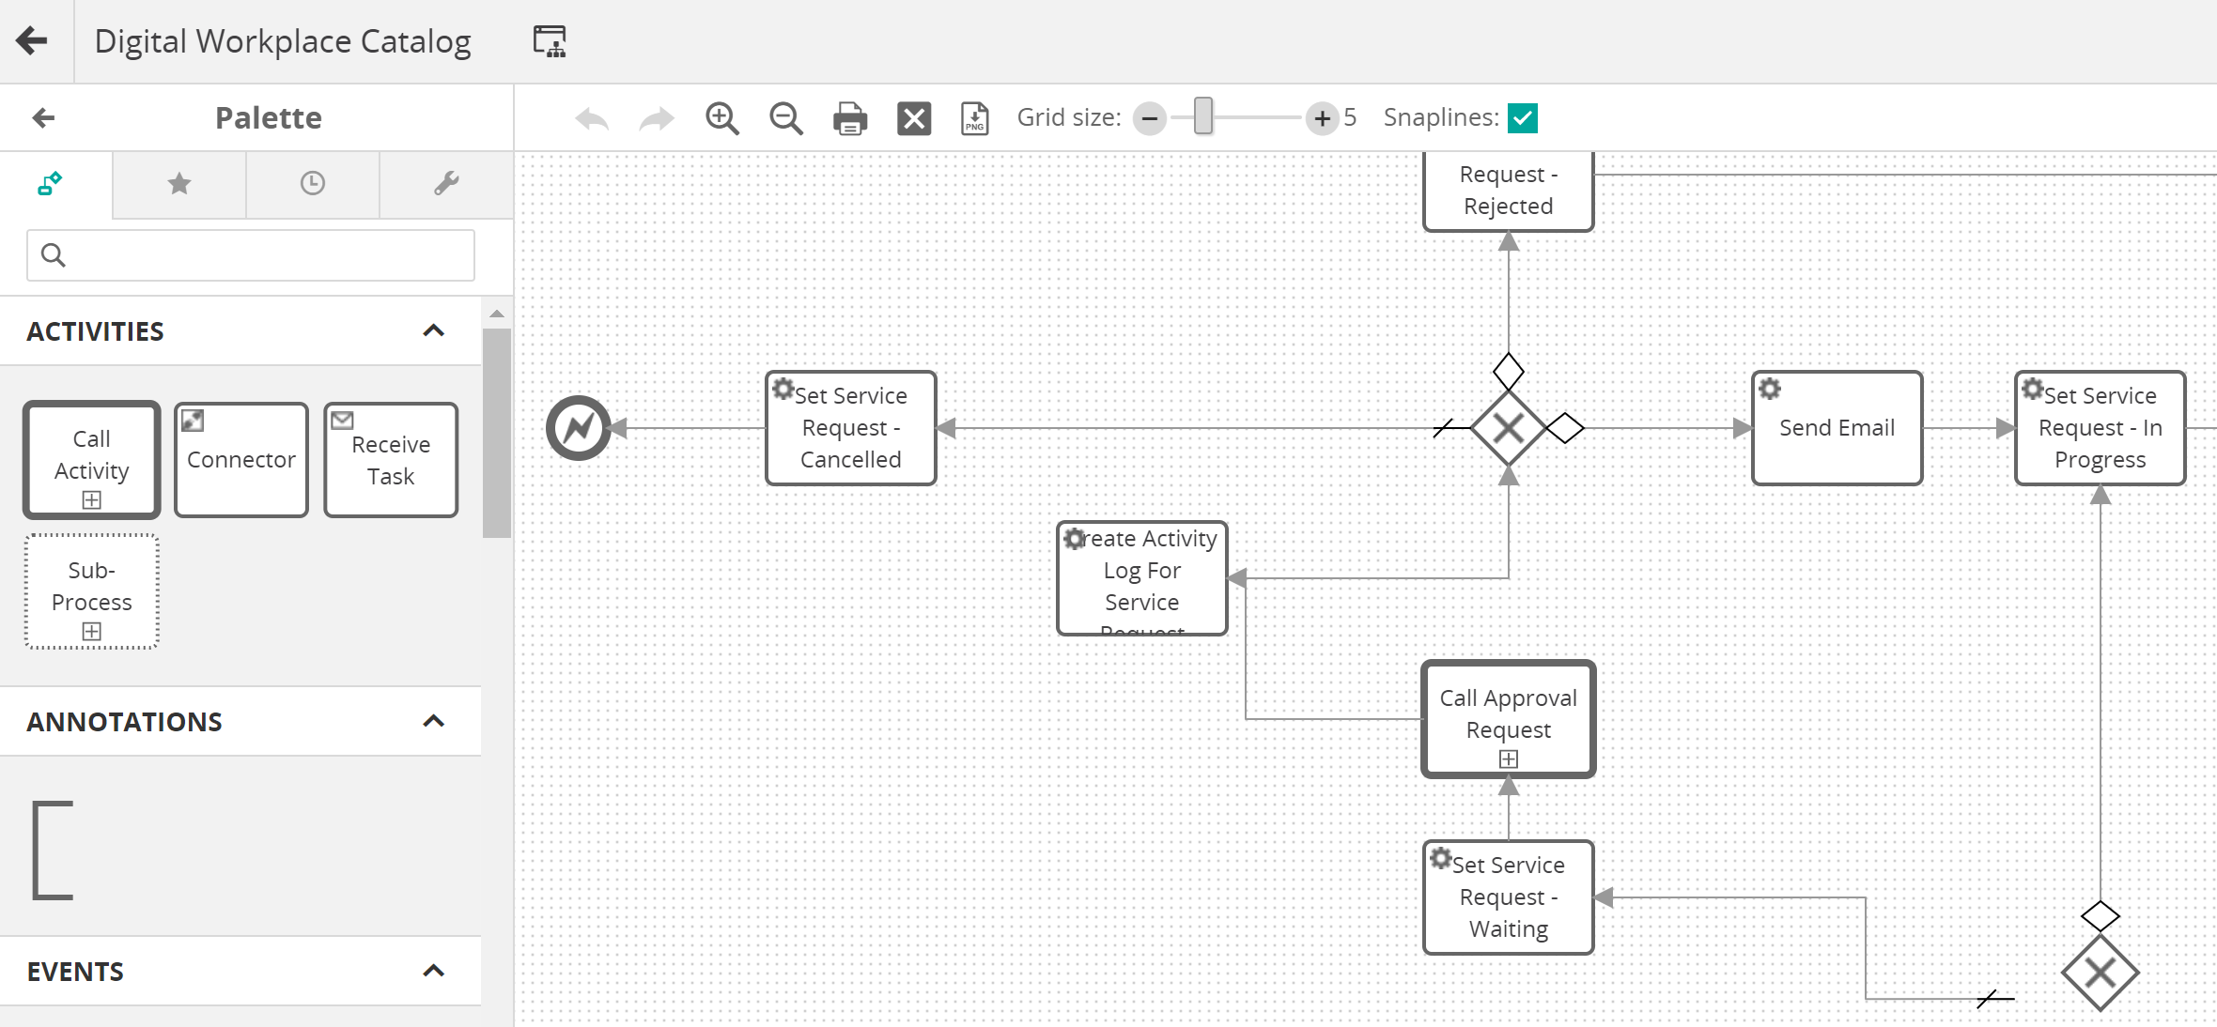
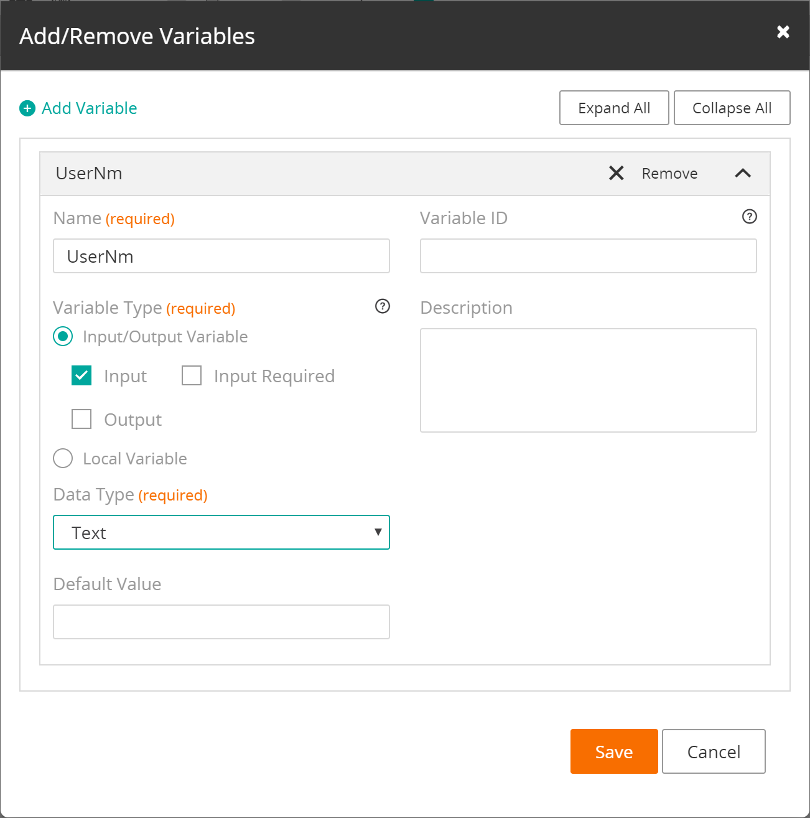
Workflow
Define the variables used in the service
  Variable name
  Type
  Required (optional)
  Default value (optional)
  Description (optional)
Define any workflow that the service will follow

Slide 9
Questions
Questions are the prompts to the user
Depending on the variable type, the questions can appear as textboxes, text areas, option buttons, calendars/time pickers, and Boolean switches
Question order is independent of variable order
Questions can be nested and appear based on configurable criteria
Actions can provide lookups and are generally used to set default values

Slide 10
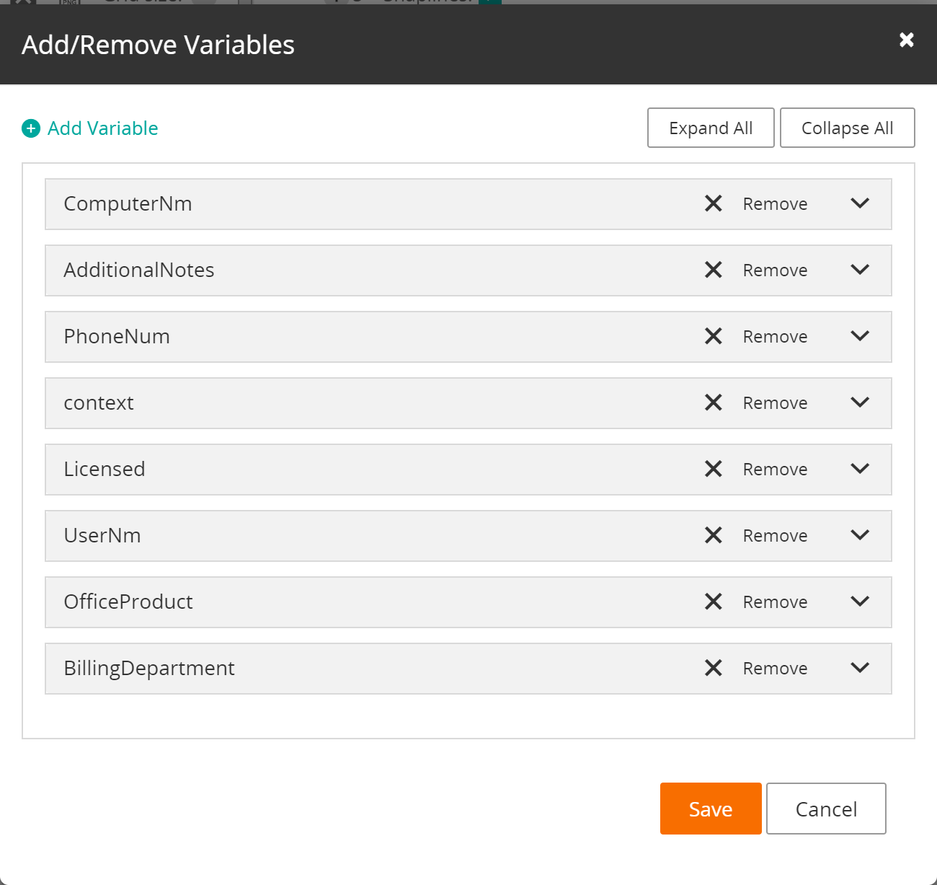

Demo: Define the variables
Create new Workflow. Best practice: Name it the same as your service
Add variables
Variable | Type | Required
context | Service Broker Context
UserNm | Text
PhoneNum | Text
ComputerNm | Text
OfficeProduct | Selection Add selections Word Excel PowerPoint Access
Licensed | Boolean
BillingDepartment | Text
AdditionalNotes | Text

Slide 11
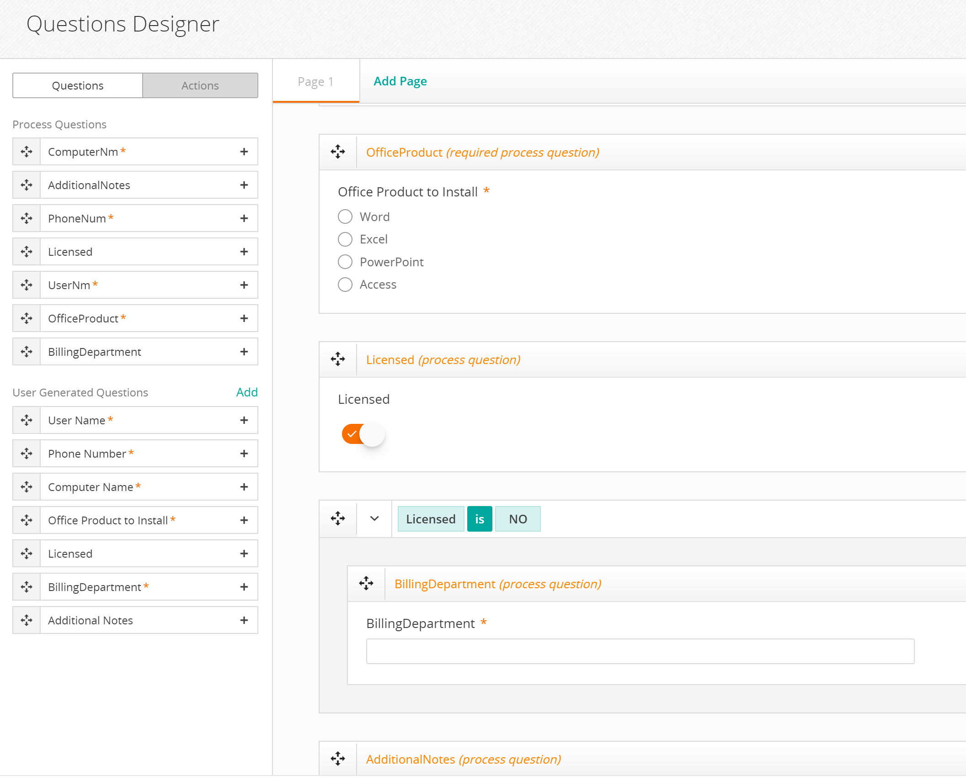
Demo: Define the Questions
Create new Questions. Best practice: Name it the same as your service
Create Questionnaire
Save and Publish your Service (Approve and Publish). You can see your results in DWP

Slide 12
Demo: Refine the Questions with Actions
Setting defaults using Actions
Phone Number and Computer Name can be preset using values from CTM:People

Slide 13
Chatbot
An interactive conversation via chat
Exposes a Service’s Questions as a dialog with a user
Captures user’s responses and uses them as answers to your service
Publish your Service to Chatbot using Innovation Studio

Slide 14
Innovation Studio
Innovation Studio is analogous to Remedy’s Developer Studio. Here you can create, modify and configure Helix applications
Chatbot is a Helix application and therefore is configured with Innovation Studio

Slide 15
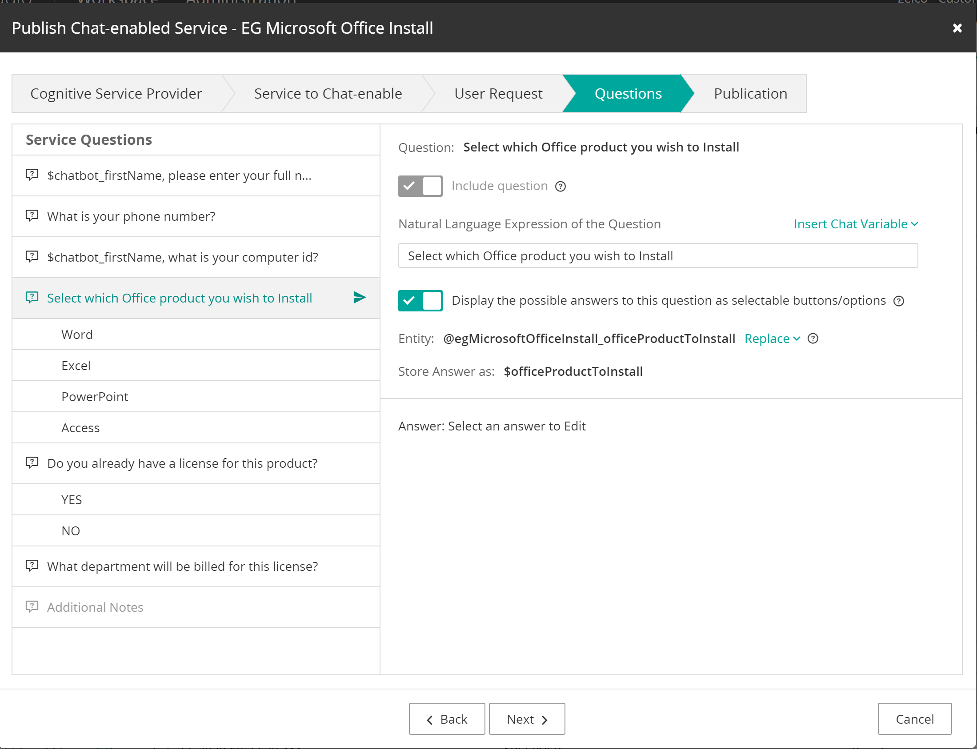
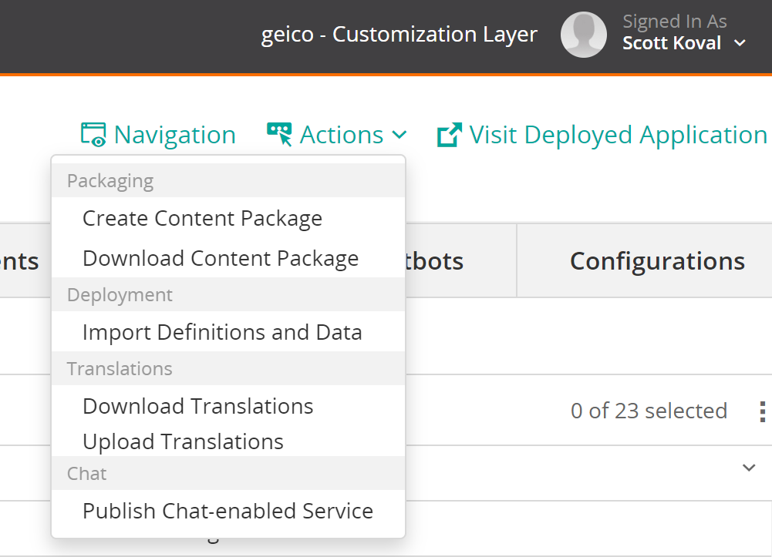
Demo: Publishing a Service to Chatbot
In Innovation Studio, select BMC Chatbot
Using the Actions menu, click Publish Chat-enabled Service
We will be following through the wizard-styled dialogs
  Define how to request through chat
  Define the questions and using variables in the questions
  Allowing the user to choose options in the Chatbot
  Publishing the Service

Slide 16
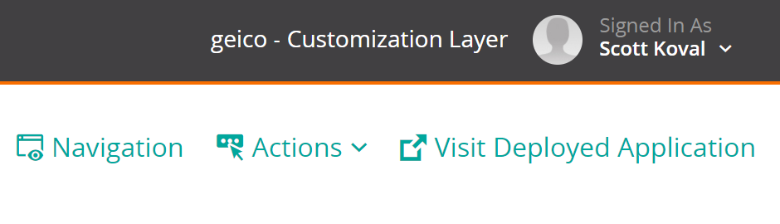
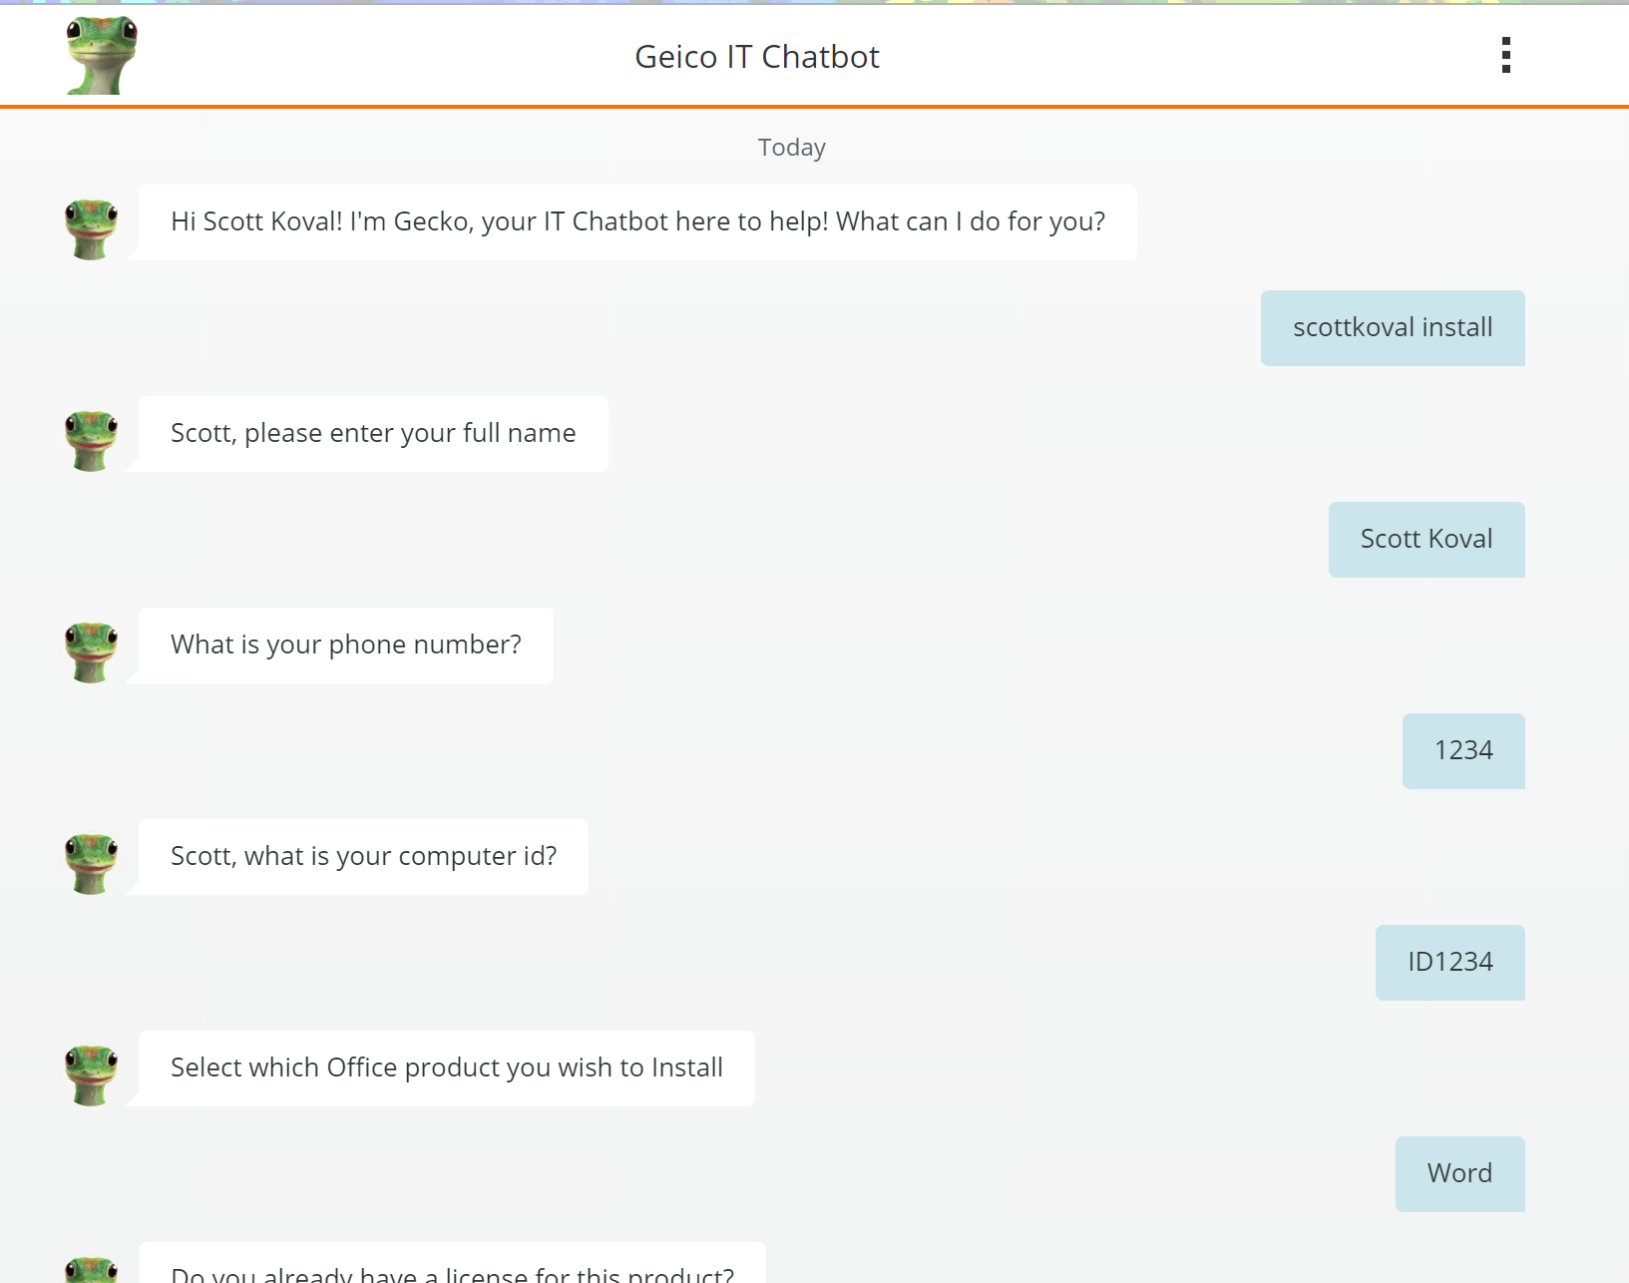
Demo: Reviewing your Service in Chatbot
Select the Visit Deployed Application link
Chatbot opens in a new tab

